Slide 1
Alternatives: An evolving and expanding investment universe
J.P. Morgan Investment Academy Series
Accessible investment education from a trusted source
Notes:
Hello, and thank you for joining me for another presentation from our Investment Academy series.
I’m [NAME/TITLE] and today’s presentation delves into the world of alternative investments.
Many people think of alternatives as a single asset class or a strategy – but by the end of our presentation, I hope you’ll have a broader understanding of this often misunderstood, poorly labeled category of investing that reaches across asset classes, investment cultures, structures, strategies and styles.
While by no means exhaustive, I’ll briefly discuss the history of alternatives and explore some of the basic features of these innovative investment solutions – many of which have been around for decades. I hope to shed some light on how and why investors and advisors incorporate them into contemporary portfolios and review the risks associated with alternatives, as well.

Slide 2
A history lesson
Financial innovation has been evolving since ancient times.
History shows that financial innovation has been a critical and persistent part of the economic landscape… [for] centuries.”
Peter Tufano, Professor of Financial Management Harvard Business School, June 2002
“
Source: World Economic Forum, 2012
Notes:
Before we get into the meat of our presentation, I’d like to offer a bit of perspective to put our subject of alternatives in context.

Slide 3
A history lesson
Financial innovation has been evolving since ancient times.
 | 9000 BC onward | 5000 BC | 4000 – 2500 BC | 2500 BC | 1700 – 1100 BC | 14th century | 1602 | 1938 | 1946 | 1949 | 1952 | 1973
Innovation | Medium of exchange | Shell money | Credit | Insurance | Annuities (first recorded) | Bonds | Publicly listed stock | Secondary mortgage market | Venture capital | Hedge funds | Direct and obvious root to the capital asset pricing model that would lead to asset allocation theory | Black-Scholes model
Description | Bartering of produce and cattle | Spondylus shells traded in southeastern Europe | Mesopotamian tables record ancient loans and interest paid | Babylonian goods transport insurance | First purchased by Egyptian prince | Was as the “father of the bond market” in Renaissance Italy | Dutch East India Company on Amsterdam Stock Exchange | Fannie Mae establishes secondary market for US mortgages | Private equity firms established in United States | Absolute Return or “hedged fund” created by Alfred Winslow Jones | Harry Markowitz’ first truly rigorous justification for selecting and diversifying a portfolio with the publication of Portfolio Selection. His mean variance analysis firmly established portfolio theory as one of the pillars of financial economics. | Nobel prize winning option-pricing model helps launch modern derivatives industry
Source: World Economic Forum, 2012
Notes:
The evolution of financial innovation dates back to ancient times. Throughout history novel approaches are often viewed initially with a fair amount of suspicion until they are proven and fully embraced by the mainstream culture.
For example, there was a time in the late 19th century when stocks were considered an alternative to the far more common bonds that comprised the bulk of most American investors’ portfolios. And it wasn’t that long ago that all international investments – stocks, bonds, currencies – were considered to be alternatives.
As you can see on this timeline, private equity and hedge funds – two of the more common strategies we think of when we talk about alternatives today – have been around since the 1940s.

Slide 4


Many alternatives are not new
Hedge funds and modern venture capital have existed for decades, and real estate and commodities have been around for centuries.
Real estate/ Natural resources
Private equity strategies
Public market strategies
Private real estate
REITs
Commodities (like gold, sugar and grains)
Energy
Timber
Venture capital
Buyouts
Distressed debt
Mezzanine
Hedge funds
Multi-strategy funds
Arbitrage
Option overlay
Managed futures
Notes:
As an industry, our history is filled with storied events and characters that make for interesting reading. But they also illustrate how innovation can transform mainstream investing. Many new instruments and strategies emerge on the fringes yet are gradually adopted by ordinary investors.
The term "alternative" often suggests new and obscure investments; but many – like commodities and real estate – have existed for decades if not centuries.
Some of you may recall our presentation about diversification and the efficient frontier theory; until recently, the investment universe was comprised principally of stocks, bonds and cash – what we refer to today as traditional investments.
To be sure, the alternatives universe is expanding. Many of the strategies and products that were out of the reach of common investors 10 years ago are migrating to more accessible markets and being transformed into specialty mutual funds and exchange traded funds.
Before we take a closer look at some of these alternatives, let’s try to define them.

Slide 5

What does “alternatives” mean?
A lack of industry consensus has caused confusion among investors.
al•ter•na•tives
offering or expressing a choice
different from the usual or conventional
existing or functioning outside the established cultural, social or economic system (e.g., an alternative newspaper, alternative lifestyles)
Notes:
For an industry with such a rich and expansive vocabulary, it’s hard to believe that we’ve lumped together so many investment choices under the umbrella of “alternatives.”
The Merriam Webster dictionary defines “alternatives” as:
offering or expressing a choice;
different from the usual or conventional
existing or functioning outside the established cultural, social, or economic system
In a way, alternatives are all of these things, but this definition doesn’t get specific enough relative to investing.

Slide 6

What does “alternatives” mean?
A lack of industry consensus has caused confusion among investors.
al•ter•na•tives
An investment that is not one of the three traditional asset types (stocks, bonds and cash).
— Investopedia
Source: http://www.investopedia.com/terms/a/alternative_investment.asp#axzz2Kcb5dBtW
Notes:
Sometimes it’s easier to define a term by expressing what it is not.
The online dictionary and financial education resource Investopedia defines alternatives as “an investment that is not one of the three traditional asset types, such as stocks, bonds and cash.”

Slide 7
What does “alternatives” mean?
A lack of industry consensus has caused confusion among investors.
al•ter•na•tives
General thinking
Everything but stocks, bonds and cash
Hedge funds
Private equity/venture capital
Real estate
Natural resources (e.g.,oil, gas, timber)
Commodities and financial futures
Precious metals
Art, antiques, gems and collectibles
Notes:
These vague descriptions illustrate the absence of a universally accepted way to consistently talk about what constitutes alternative or traditional investments – what they are, how they differ from one another and how best to categorize, understand and integrate them into client portfolios. This lack of consensus has caused a great deal of confusion among institutions, advisors and investors.
New structures, asset classes, products, strategies and approaches steeped in new regulations – have complicated the situation, with implications for portfolio construction and investment results.

Slide 8
A working definition for today’s presentation
While alternatives take many forms, they also share common characteristics.
Working definition
Any investment that extends beyond traditional stocks, bonds and cash, or any unique structure or strategy that ventures beyond the conventional way of buying and selling stocks and bonds
Shared characteristics of alternatives
Historically low to moderate correlation with traditional stock and bond asset classes
Not listed on an exchange
Private investment funds available only to high net worth and institutional investors
Reduced liquidity
Notes:
For our purposes, we’ll settle for a working definition of alternatives as: any investment that extends beyond traditional stocks, bonds and cash, or any unique structure or strategy that ventures beyond the conventional way of buying and selling stocks and bonds.
Until very recently, most alternative assets were held by institutional investors or accredited, high net-worth individuals because of their complex nature, limited regulations and relative lack of liquidity.
Some of the characteristics that many alternatives share in common, include:
Historically low to moderate correlation with traditional stocks and bonds
Assets not necessarily listed on an exchange
Private investment funds available only to high net worth and institutional investors
Reduced liquidity

Slide 9
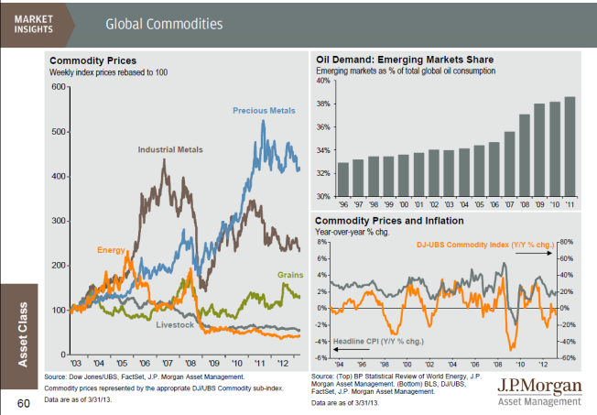
Some alternatives are asset classes
They differ dramatically from the traditional asset classes of stocks, bonds and cash assets.
Notes:
We look at the alternatives world through several different lenses.
From one perspective, some alternatives are types of assets– like real estate, natural resources, gold, and commodities; they differ dramatically from traditional stocks, bonds and cash assets in the way they behave, perform and respond to economic forces.
In this illustration from our quarterly Guide to the Markets we show the weekly price changes in the indices for some of the most actively traded commodities like energy, grains and precious metals. These commodities are considered alternatives because of their unique attributes in a portfolio setting.
Previously, if people invested in commodities at all, it was generally through stocks – like mining, energy or materials companies. So rather than invest directly in livestock or grain, you might get exposure to agricultural commodities by investing in: Deere & Company the farm and construction equipment maker; or Archer Daniels Midland Company, an ethanol producer and one of the world’s largest processors of wheat, corn, oilseeds, and cocoa.
The first commodity futures mutual funds were launched in 1997 and the creation of the first physical commodity exchange-traded fund debuted in 2004.

Slide 10

Some alternatives are classified by their behavior
Different risk types, styles and strategies can be combined to achieve very specific investment goals.
Examples of alternative “beta”
Examples of alternative styles
REITs
Gold
Commodities
Natural resources
In most cases, manager skill is central to the performance of an alternative investment.
Market neutral
Long/short
Managed futures
Global macro
The above diagram is for illustrative purposes only.
Notes:
The essence of what makes an investment an “alternative” is sometimes based on how that asset behaves.
As you may recall from prior presentations, Beta is a measure of the volatility, or systematic risk, of a security or a portfolio in comparison to the market as a whole. Alpha is a measure of a portfolio’s excess returns and expected performance, given its level of risk. Alternative “beta” suggests that alternative assets represent different types of risk than those associated with “traditional” asset classes.
Another view encompasses alternative styles and strategies – the freedom to take long and short positions, for example, in any number of assets; or to combine traditional stocks and bonds with managed futures or derivatives, or entire portfolios comprised of multiple asset classes and non-traditional strategies.
Alternatives might hold long and short securities positions, private and/or publicly traded investments, and may employ derivatives or hedging strategies. Investors choose alternatives for a variety of reasons, including achieving a particular level of absolute return as opposed to relative performance versus an index. This absolute return focus, as opposed to the benchmark-driven world of mutual funds – affords managers significant freedom to achieve a range of investment objectives.
Another defining characteristic of most alternatives, is that manager skill is central to the process. Unlike traditional assets though, some alternatives managers are rewarded for the results they achieve. Many hedge funds, for example, charge both a management fee, typically about 2% of the fund’s net asset value year, and a performance fee of 20% of the fund's profit.

Slide 11
Some alternatives are defined by their structure
This dictates the regulatory framework within which alternatives operate.
Private equity
Negotiated private investments in (most often) non-public companies at different stages of maturity with the objective of reselling at a higher price in the future.
Hedge funds
Investment funds that invest primarily in the global equity and fixed income markets, typically employing sophisticated trading strategies, using leverage and derivate instruments that also typically involve greater risks.
Fund of funds
Actively managed portfolios of hedge funds and other alternative investment products. Investment funds that invest primarily in the global equity and fixed income markets, typically employing sophisticated trading strategies, using leverage and derivate instruments that typically also involve greater risks.
Real estate trusts and limited partnerships
Negotiated private investments in real estate assets with the objective of generating current income and/or reselling at a higher value in the future.
Managed futures
Investments in global markets including futures, options and forwards on traditional commodities, financial instruments and currencies.
Alternative mutual funds
Increasingly, alternative assets and strategies have migrated to conform with the registered mutual fund structure, affording advantages of daily liquidity, greater transparency and affordability.
Notes:
Finally, another view involves the structure of investments categorized as alternatives; these dictate the regulatory framework within which alternatives operate. Sometimes these are used synonymously with “asset classes.”
Within the “alternatives” space, investors today may choose from several basic categories, including:
Private Equity Funds
Hedge Funds
Limited Partnerships
Fund Of Funds
Real Estate
Managed Futures
Alternative Mutual Funds

Slide 12
How alternatives differ from traditional investments
While alternatives are quite different, the gap is narrowing somewhat.
Traditional investments | Alternative investments
Relative performance objective | Absolute performance objective
Generally no leverage | May use leverage
Performance dependent primarily on market returns | Performance dependent primarily on advisor skill
Historically high correlation with market indices | Historically low to moderate correlation with market indices
Typically offers daily liquidity | Typically have reduced liquidity ranging from monthly to 12+ year lock-ups
Fixed management fee on assets under management | Generally higher fees that may include performance fees
Notes:
In general terms, traditional investments differ from alternatives in several ways – although the gap is narrowing, somewhat.
For example, traditional investments typically are judged on a relative performance basis – usually as compared to a benchmark or a market index. Alternative investments, on the other hand, often pursue an absolute return objective, and performance is dependent primarily on advisor skill.
Traditional investments typically offer daily liquidity; in contrast, many alternative choices have liquidity restrictions that can range from one month to 12-plus years.
Historically, traditional investments have had high correlation with market indices, while alternatives historically have demonstrated low to moderate correlation with market indices – which makes them ideal in a blended portfolio setting.
Finally, alternative investments generally charge higher fees that may include performance fees.

Slide 13
Alternative investments doubled from 2005 – 2011
Alternative investments grew at a compounded annual growth rate of 14% compared to traditional assets at 2%.
Alternative investments have grown faster than non-alternatives over the last 6 years and have surpassed peak 2007 levels
Global AUM (2005 – 11) $ Trillion
CAGR (2005 – 11)
14.2%
1.9%
48.6
49.8
n Alternatives
n Non-alternatives
44.0
46.0
45.4
37.7
40.4
Alternatives account for 16% of the global institutional market and 9% of the global retail market
Source: Strategic Insight, McKinsey Global Asset Sizing Database
Notes:
Let’s shift gears for a minute and talk about the growth of alternative investments.
As the slide illustrates, alternative investments have been growing in popularity. They outpaced traditional investments by a large margin during the period from 2005 to 2011.

Slide 14
Alternatives are no longer the exclusive realm of institutions
Through mutual funds, retail investors are now adopting alternative investment styles and strategies.
Alternatives are experiencing strong growth in the retail market, particularly in U.S. mutual funds
U.S.
Non-U.S.
+11% p.a.
+21% p.a.
Retail alternative¹ AUM, $ billion
Retail alternative¹ AUM, $ billion
3%
4%
4%
5%
6%
6%
7%
8%
10%
11%
12%
11%
11%
10%
Share of all long-term retail fund AUM²
Share of all long-term retail fund AUM²
¹Alternatives includes absolute return, commodities, currency trading, dedicated short bias, equity energy, leveraged strategies (both long and inverse), managed futures, market neutral, multi-strategy alternatives, natural resources, options arbitrage, precious metals, real estate and volatility strategies; excludes distressed debt.
²Includes mutual funds, closed-end funds, ETFs and UCITs structures, and excludes limited partnerships and separately managed accounts.
Source: McKinsey/Institutional Investor Global Survey on Institutional Investing, 2011
Notes:
Alternatives were once reserved for large institutional investors.
But one of the biggest changes over the past 10 years, as illustrated in this bar chart, is that retail investors are now able to incorporate alternative investment styles and strategies thanks to a growing percentage of mutual funds that invest in alternatives.

Slide 15
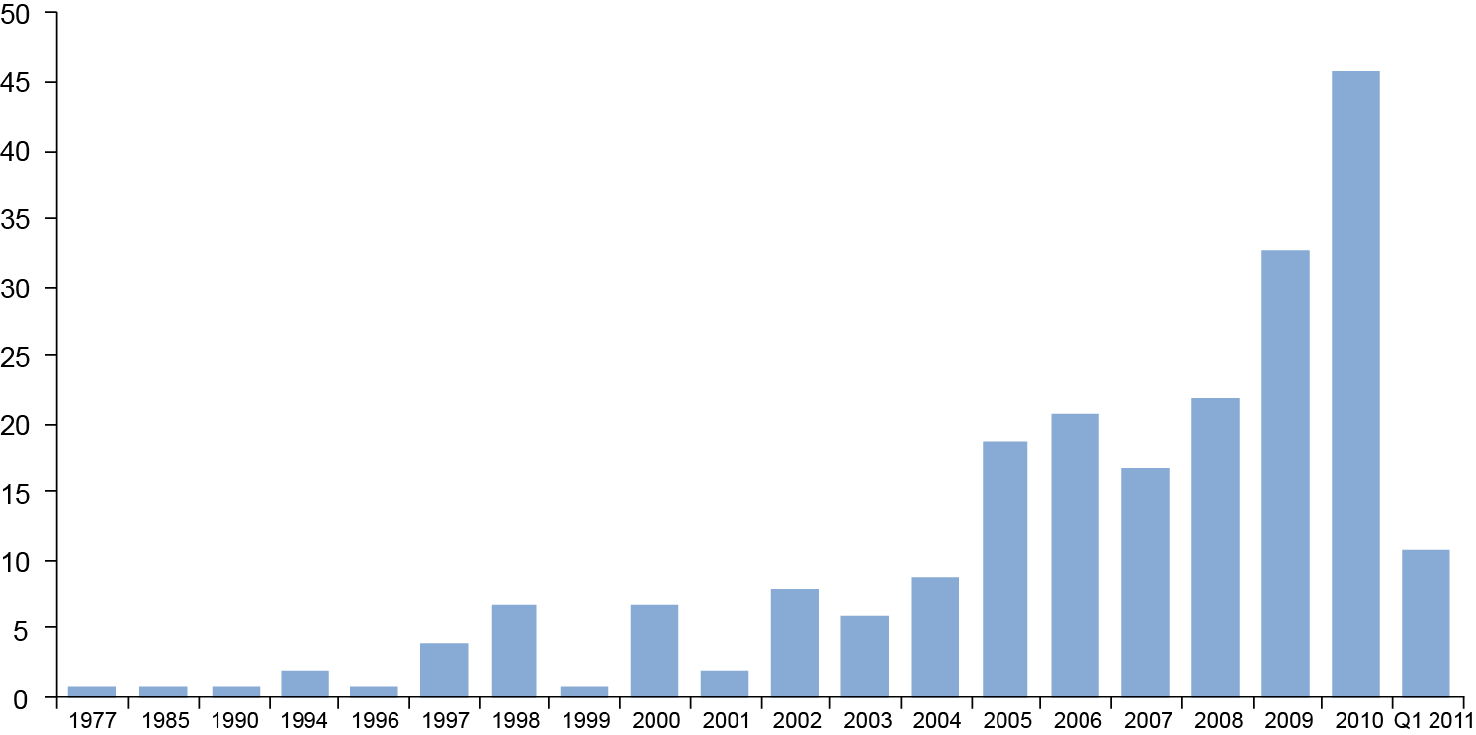
A flood of new alternative investments
Morningstar tracks 521 mutual funds and ETFs utilizing alternative investments.
Alternative mutual fund launches
225 mutual funds and 296 ETFs
Source: Morningstar, J.P. Morgan Asset Management , May 2012
Notes:
This chart shows the explosive growth in the number of new “alternative” funds – both mutual funds and Exchange Traded Funds – launched in the U.S. market place in the last decade.
According to Morningstar, as of 2012 they are tracking 521 such funds; 225 are mutual funds and 296 are Exchange Traded Funds.

Slide 16
Top alternative strategies
Long/short, multi-asset, currency, absolute return and market neutral strategies are among the most popular.
Top alternative strategies being considered or currently in development in a 1940-Act Mutual Fund structure, 2012
Long-short/ extension strategies
Multi-alternative/ alternative action
Currency
Absolute return
Market neutral
Commodities – precious metals
Private equity/ venture capital
Managed
Source: The Cerulli Edge, Alternatives Issue, May 2012, Issue #177
Notes:
And this illustration shows the most popular types of new funds in development or under consideration in 2012 from research specialist Cerulli and Associates. The orange portion of each bar represents the number of new products under consideration, while the dark gray color indicates the number of new funds in development.
Some of the most popular strategies include long/short, multi-asset, currency, absolute return and market neutral funds.

Slide 17
Acceptance growing despite lingering perceptions
Lingering perceptions
lack of liquidity
Minimums too high
Too complicated
Limited transparency
Registered alternatives, including mutual funds and funds of hedge funds, offer unique benefits to investors when compared to non-registered alternatives:
Generally offer lower investment minimums
No limit to the number of investors in the fund
Can be sold to a much broader range of investors
Generally means there is increased transparency when compared to unregistered funds
Registered funds of hedge funds still use similar investment strategies as traditional hedge fund strategies
Notes:
Since the 1990s, alternative investments have enjoyed tremendous acceptance among institutional, endowment and high net worth investors. Yet many struggle to understand alternatives and view them as high risk, complicated strategies whose benefits do not justify their higher costs.
In some respects, these observations still may be justified; but these assumptions are changing and their reception is growing. Registered alternatives, including mutual funds and fund-of-hedge funds have recently gained more visibility among investors and advisors.
Registered as investment companies under the Investment Company Act of 1940 they offer some unique benefits to investors when compared to non-registered alternatives:
They generally offer lower investment minimums
No limit to the number of investors in the fund
They can be sold to a much broader range of investors
Registration generally means there is increased transparency when compared to unregistered funds
Registered fund of hedge funds still use similar investment strategies as traditional hedge fund strategies

Slide 18
Why do investors like alternatives?
With their low correlation to traditional assets, alternatives may help achieve greater portfolio diversification.
Addressing portfolio diversification with a low correlating asset
Enhance risk-adjusted return profile
Absolute returns
Client demand
Mitigate inflation risk
Different investment techniques
Offer clients investments they wouldn’t find on their own
Source: Morningstar, J.P. Morgan Asset Management , May 2012
Notes:
So, why do advisors and investors like alternatives and what role do they play in a portfolio?
Among the reasons cited most frequently in industry research is the fact that alternatives may help achieve greater portfolio diversification because of their low correlation to traditional assets.
In a Morningstar survey that was published in May 2012, advisors and institutions report choosing alternatives primarily for their diversification characteristics, but there are other reasons, including:
Their enhanced risk-adjusted return profile
Their potential absolute returns
Greater client Demand
Inflation protection
Unique investment styles and techniques, and
Because of their exclusivity
So let’s take a look at how these alternatives might be incorporated into an investor portfolio.

Slide 19
Incorporating alternatives for greater diversification
Compared to a traditional portfolio, a more diversified allocation may produce greater long-term returns with less risk.
Traditional portfolio
More diversified portfolio
■ | S&P 500
■ | Barclays Agg.
■ | MSCI EAFE
■ | Barclays Agg.
■ | S&P 500
■ | MSCI EAFE
■ | Russell 2000
■ | Equity Mkt. Neutral
■ | Commodities
■ | REIT
■ | MSCI EM
1994 – 2012
Return: 6.75%
Standard deviation: 10.94%
1994 – 2012
Return: 7.09%
Standard deviation: 9.97%
Source: Slide #62, 1Q13 Guide To The Markets
Indexes and weights of the traditional portfolio are as follows: U.S. stocks: 55% S&P 500; U.S. bonds: 30% Barclays Capital Aggregate; International stocks: 15% MSCI EAFE. Portfolio with 25% in alternatives is as follows: U.S. stocks: 22.2% S&P 500, 8.8% Russell 2000; International Stocks: 4.4% MSCI EM, 13.2% MSCI EAFE; U.S. Bonds: 26.5% Barclays Capital Aggregate; Alternatives: 8.3% CS/Tremont Equity Market Neutral, 8.3% DJ/UBS commodities, 8.3% NAREIT Equity REIT Index. Return and standard deviation calculated using Morningstar Direct. Charts are shown for illustrative purposes only. Past returns are no guarantee of future results. Diversification does not guarantee investment returns and does not eliminate risk of loss. Data are as of 12/31/2012.
Notes:
In practice, advisors and investors combine traditional and alternative products and strategies in terms of the kinds of problems they attempt to solve. For example, among the various goals investors may be seeking to achieve are:
Liquidity
Current income
Long-term capital appreciation
Tax-aware/ tax-favored returns
Emergency and short-term transition funds
Future liability funding
Medium term growth
Capital preservation
Retirement income
The pie chart illustrations from our Guide to the Markets show how a more robust allocation – the example on the right – may produce greater long-term returns with less risk.
Advisors may add alternatives to a traditional allocation model or choose a single solution portfolio that actively manages exposure to various asset classes.

Slide 20
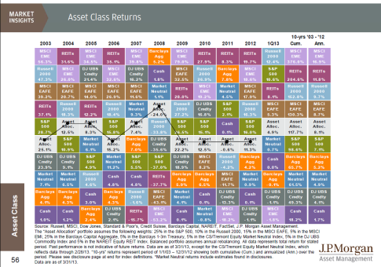
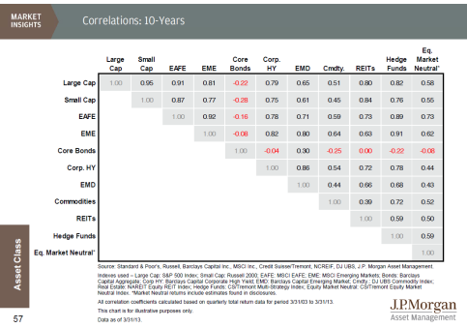

The importance of diversification and correlation
During different economic cycles, one asset class may gain while another may lag.
Source: 1Q13 Guide to the Markets, J.P. Morgan Asset Management, Dec. 31, 2012
Notes:
These two slides from our Guide to the Markets quarterly illustrate the value of diversification.
On the left, our periodic table of asset returns shows that a broadly diversified portfolio, including alternatives such as real estate investment trusts, commodities, emerging markets, and market neutral strategies may help boost long-term total returns while tempering risk over time.
The correlation chart from the Guide on the right highlights various alternatives to illustrate their relationship to traditional assets. As you may recall from previous conversations, correlation describes the relationship between the price movements of two securities or classes of securities in relation to one another. This relationship, expressed by what is known as the correlation coefficient, is represented by a value on a scale from positive 1 to negative 1. These correlation relationships mean that, during different economic cycles, while one asset class may zig, another may zag.
If we focus for a minute on equity market neutral strategies in the far-right column, most of the relationships are positive. But over the last 10 years, they have demonstrated low to very low correlation to traditional equities and a negative relationship to bonds – precisely the reason you’d want to combine these assets in a broadly diversified portfolio.

Slide 21
Risks associated with alternatives
While return potential can be significant, the positive attributes of alternatives have a price.
Liquidity
Leverage/ derivatives
Event risk
True assessment
Access
Loss
Alternative assets often are less liquid than stock or bonds.
Many alternatives, especially hedge funds, employ sophisticated return enhancement tools, such as leverage and derivatives, that typically also involve greater risk.
Many alternatives are subject to event risk. Which means that, given their niche specialization, market dislocations can affect some strategies more adversely than others.
Accurately assessing values and risks may be difficult.
Investors may not have access to a given investment.
Greater investing freedom can increase potential for mismanagement or loss from sector exposure.
Notes:
Of course all the positive attributes of alternatives have a price. While return potential can be significant, so are the potential risks associated with alternatives.
Let’s briefly talk about the risks associated specifically with alternatives. Investors can lose all or a substantial portion of their investment due to leveraging, short-selling or other speculative investment practices. Some of the risks to keep in mind include:
Liquidity - Depending on the alternative asset, investors may or may not be able to find a willing buyer when they’re ready to sell. Also, some hedge funds may require investors to stay invested for a certain period of time.
Leverage
Access to information – the performance of an alternative asset can be challenging to research, price, and understand.
Restricted market access - Investors must meet suitability requirements for investing, including income level and minimum investment; some investors may not be permitted to invest in a hedge fund.
Greater investment latitude - Because they are subject to less regulation than other investments, there are fewer constraints to prevent potential manipulation or to limit risk from highly concentrated positions in a single investment. Also, hard assets such as bullion, antiques, art or gems are subject to physical risk and may involve special considerations such as storage and insurance, while timberland may be subject to natural disasters.

Slide 22
Summary
The investment landscape is constantly changing as new perspectives on risk and opportunity shift.
The term "alternative" may suggest new and obscure investments; but many — like commodities and real estate — have existed for decades if not centuries.
The absence of a concrete definition of alternative investments has created confusion.
Alternative strategies are increasingly being adopted by mainstream investors.
Combining traditional and alternative assets in an asset allocation framework has the potential to help investors achieve their long-term investment goals in today’s global financial markets.
Notes:
We’ve covered a lot of material today. So let me try to summarize the highlights of our presentation.
We talked about how investment innovations always have, and will continue to, shape the investment landscape.
We discussed the challenge of defining alternatives and how the industry has failed to present a universally accepted way to categorize alternative and traditional and how best to integrate them into client portfolios.
We touched on the characteristics of the most common alternative assets, as well as the strategies, structures, and investment styles used by hedge funds, private equity funds, real estate and commodities-oriented portfolios.
We reviewed the reasons why alternatives have attracted the attention of institutional investors, advisors and their clients including their exclusivity, their low correlation to traditional investments and the flexibility afforded management to enhance risk-adjusted returns.
Finally, we conclude that a well diversified portfolio that combines traditional and alternative assets in an asset allocation framework has the potential to help investors achieve their long-term investment goals in today’s global financial markets.

Slide 23
Thank you
Notes:
Thank you for the opportunity to share our insights on alternative investments.
It’s a vast marketplace that’s constantly shifting and an exciting time to be an investor.

Slide 24
J.P. Morgan Asset Management
Investing in alternative assets involves higher risks than traditional investments and are suitable only for the long term. They are not tax efficient, and have higher fees than traditional investments. They may also be highly leveraged and engage in speculative investment techniques, which can magnify the potential for investment loss or gain.
The above commentary is intended solely to report on various investment views held by J.P. Morgan Asset Management. Opinions and estimates offered constitute our judgment and are subject to change without notice, as are statements of financial market trends, which are based on current market conditions. We believe the information provided here is reliable, but do not warrant its accuracy or completeness. This material is not intended as an offer or solicitation for the purchase or sale of any financial instrument. The views and strategies described may not be suitable for all investors. This material has been prepared for informational purposes only and is not intended to provide, and should not be relied on for, accounting, legal or tax advice. References to future returns are not promises or even estimates of actual returns a client portfolio may achieve. Any forecasts contained herein are for illustrative purposes only and are not to be relied upon as advice or interpreted as a recommendation.
J.P. Morgan Asset Management is the marketing name for the asset management businesses of JPMorgan Chase & Co. Those businesses include, but are not limited to, J.P. Morgan Investment Management Inc., Security Capital Research & Management Incorporated and J.P. Morgan Alternative Asset Management, Inc.
© J.P. Morgan Chase & Co., March 2013

Slide 25
声明：
所有的版权属于原有公司，文件均来自公开渠道
此文件仅供学习使用，任何人不得进行以此为商业目的的行为
如有疑问，请立即删除
学习世界五百强和咨询公司PPT课程请访问如下网站搜索：“司马懿”
百度传课：司马懿PPT学校
https://www.chuanke.com
网易学堂：司马懿PPT学校
https://study.163.com
知乎： 司马懿PPT学校
https://www.zhiu.com

